Slide 1
‘insert Practice name’
Presentation for the clients of

Slide 2
What is the BankLink service?
The BankLink service is used by more than 3000 accounting practices in Australia and New Zealand
BankLink was established over 20 years ago in 1986
BankLink helps accountants to process their clients’ accounts and prepare tax and GST returns efficiently
BankLink frees small business owners from the need to spend hours using accounting systems, from employing costly book-keepers and from needing to learn how to be an accountant

Slide 3
Why has the practice decided to use this system now ?
The complexity and cost of accounting for business is continually increasing
People are too busy running their own businesses to become book-keepers or accountants
If the practice charged for all the time spent small businesses would find it hard to pay the bill
BankLink provides a simpler and faster way to “do the books”

Slide 4
How does the BankLink service work ?
BankLink collects statement data from the banks
BankLink sends these electronic statements to the accountant
The accountant reviews the transactions
The accountant sends a Coding Report or BankLink Notes file to clients listing any transactions they require more information to code
Clients “fill in the blanks” and send back to the accountant
The accountant uses the information to complete the tax and accounting processing

Slide 5

Step One: Banks send data to BankLink
Banks send an output file to BankLink
This is an electronic copy of your bank statement
BankLink complies with the Banks’ security requirements
BankLink has no transactional capability or access
Financial
Institutions

Slide 6
Step Two: BankLink sends the data to the accountant
BankLink collates the data from the banks and sends this to the accountant every month
An encrypted data file, readable only by us, and only usable with the BankLink software is sent to our practice
Financial
Institutions
The
Practice

Slide 7
Step Three: Accountant reviews the transactions
We use BankLink Practice to review and code the transactions for tax & accounting purposes
We would have traditionally done this using your paper bank statements, cash books and/or data output files from small accounting systems
Financial
Institutions
The
Practice

Slide 8
Step Four: Accountant sends a coding report to clients
We send you a list of the transactions we require more information to code, via email, fax or post
This may happen monthly or quarterly - and it does not require much of your time, nor does it require you to be an accountant
Your
business
Financial
Institutions
The
Practice

Slide 9
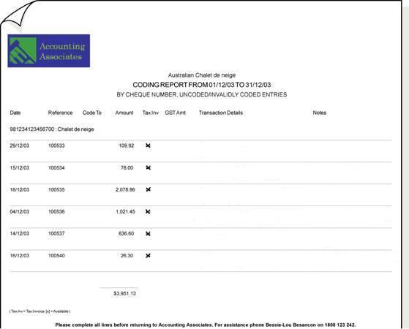
BankLink Coding Report (via email, fax, or post)

Slide 10
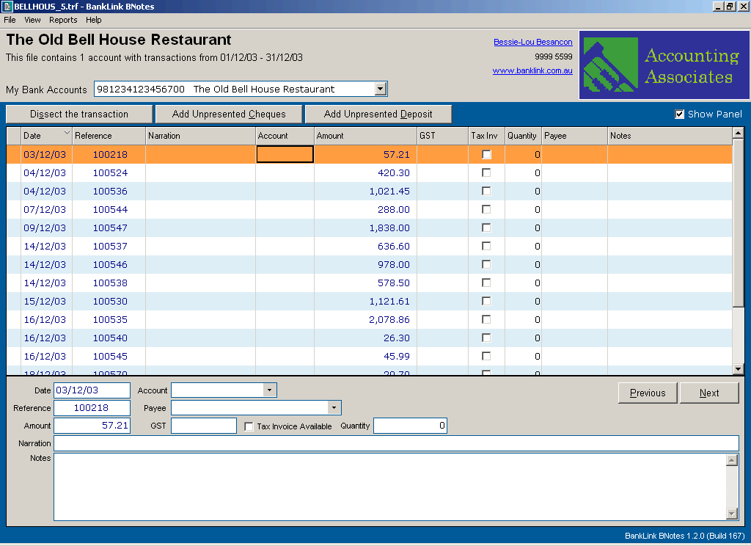
BankLink Notes file - via email

Slide 11
Step Five: Clients “fill in the blanks” and send it back
Once you have filled in the codes, or provided descriptions of the transactions, you send the report or file back to us at the practice
Your
business
Financial
Institutions
The
Practice

Slide 12

Step Six: Accountant completes the accounts and tax
We use the information you have provided to complete your accounting work
We prepare financial statements and lodge tax returns electronically with the ATO
Your
business
Financial
Institutions
The
Practice

Slide 13
What are the benefits ?
You spend your time doing what you do best: running your business and creating profits
We do what we do best: preparing accurate and timely financial reports and tax returns
Your accounting & taxation is handled by professionals - we are able to provide expertise efficiently and cost-effectively by using BankLink in our accounting practice

Slide 14
In summary
BankLink allows us to work far more efficiently
BankLink is proven, safe & secure
The BankLink service frees you from doing the books yourself, and even from sending your bank statements and cheque butts in
BankLink allows us to provide truly valuable business advice using current, not historic, data
BankLink is supported by over 100 Banks, Credit Unions, Building Societies and Rural Suppliers in Australia & New Zealand
Over 200,000 accounts in over 3000 accounting practices are processed every month using BankLink

